Slide 1
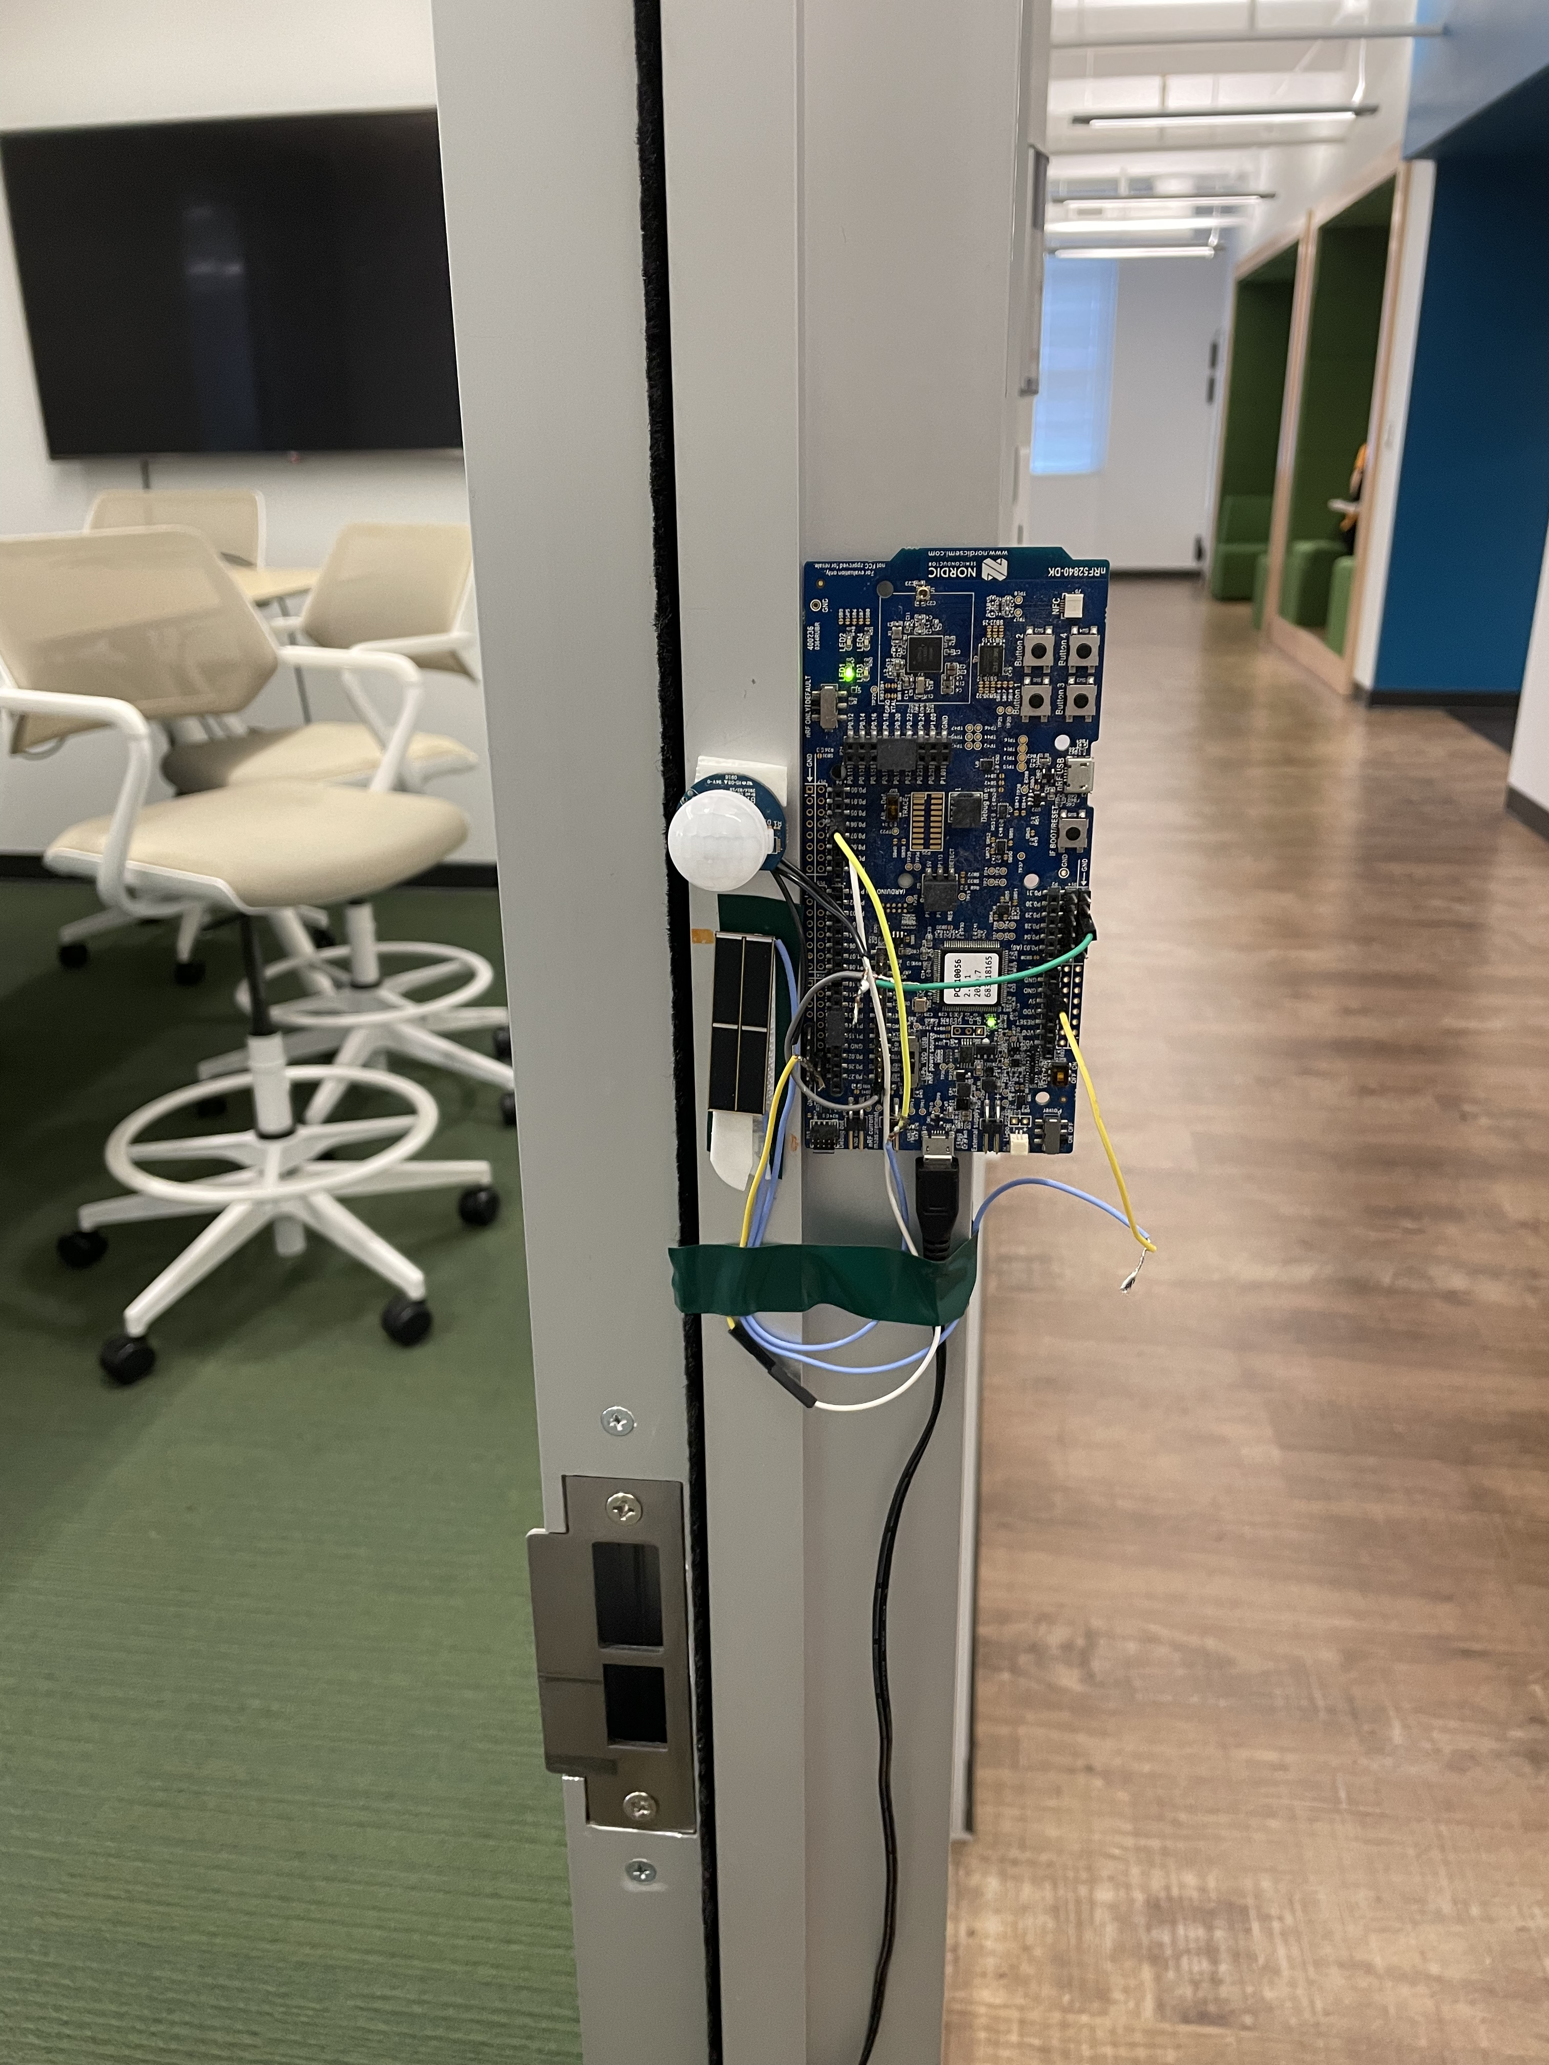

SolarWalk: Smart Home Occupant Identification using Unobtrusive Indoor Photovoltaic Harvesters
Nurani Saoda*, Md Fazlay Rabbi Masum Billah*, Victor Ariel Leal Sobral, Tushar Routh, Wenpeng Wang, Bradford Campbell
University of Virginia
ACM BuildSys’22, Nov 9-10, 2022
Link Lab

Slide 2
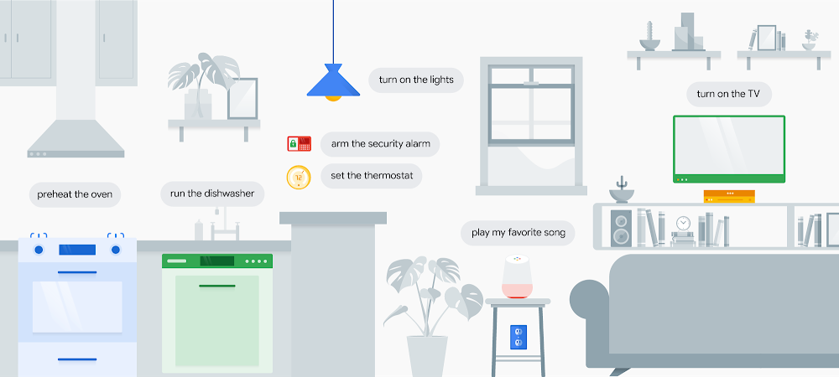
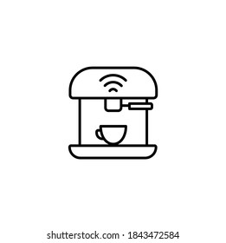

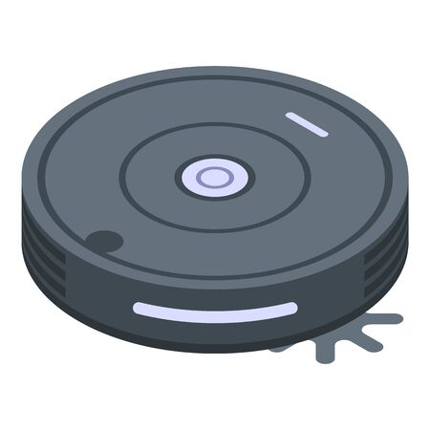
Identifying occupants in smart homes is important
Link Lab
“Set the light to Relaxing evening”
{Event: “When Alice enters home” }
{Event: “When Alice exits” }
“Set the thermostat to ‘Cozy winter’”
“Start making cappucino”
“Get milk today”
“Play mozart”
“Left your keys”
“Start dishwasher”
+ Improved user comfort and convenience + Reduce energy consumption
“Start deep cleaning”

Slide 3
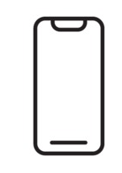

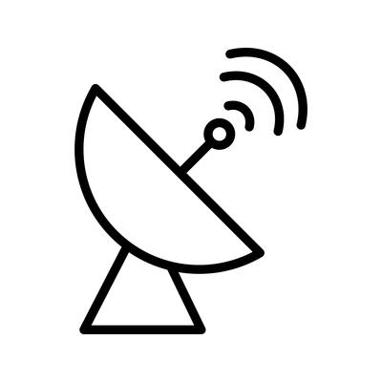



Many smart building research has focused on this problem
Link Lab
Device-based
RF-signal-based (Wifi, BLE)
Occupant Identification
Radar-based
Camera/vision-based
Special purpose hardware-based (ultrasonic, acoustic)
On-device object-based

Slide 4
Still, many practical challenges exist ..
Link Lab
Device-based
Requires user to wear/carry device
Camera/vision-based
Privacy-invasive
RF-signal-based (Wifi, BLE)
Susceptive to signal multipath
On-device object-based
Requires direct user interaction
Radar-based
Installation-heavy
Special purpose hardware-based (ultrasonic, acoustic)
Special purpose infrastructure required

Slide 5
Link Lab
How can we design a smart home occupant identification system that -
Can be ubiquitously, unobtrusively, and scalably deployed
Builds on existing devices: Does not require additional hardware
Is installation-friendly
Is energy-efficient?
Notes:
Build on existing systems
Does not require special-purpose hardware like Radar, sonar, acoustic Scalable
Installation-friendly: Does not require multiple devices

Slide 6
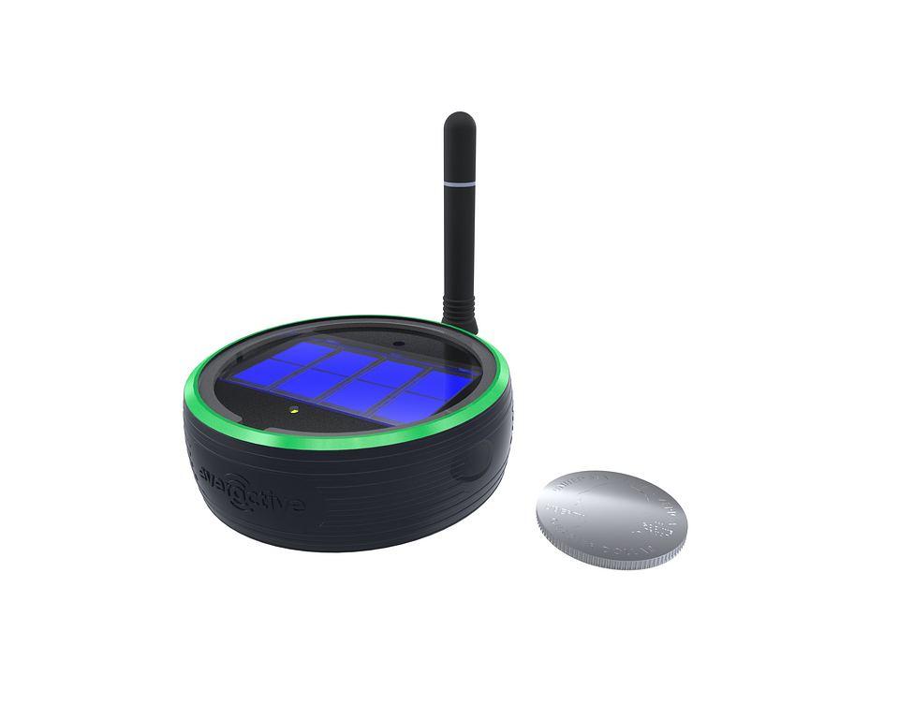
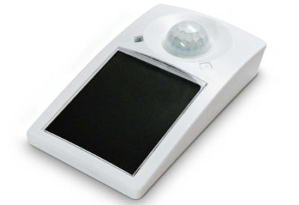
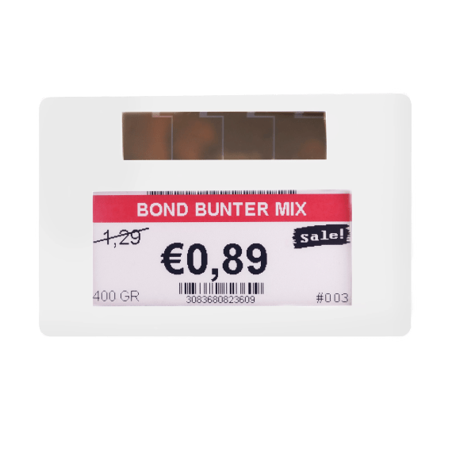
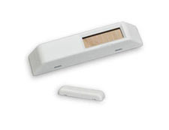
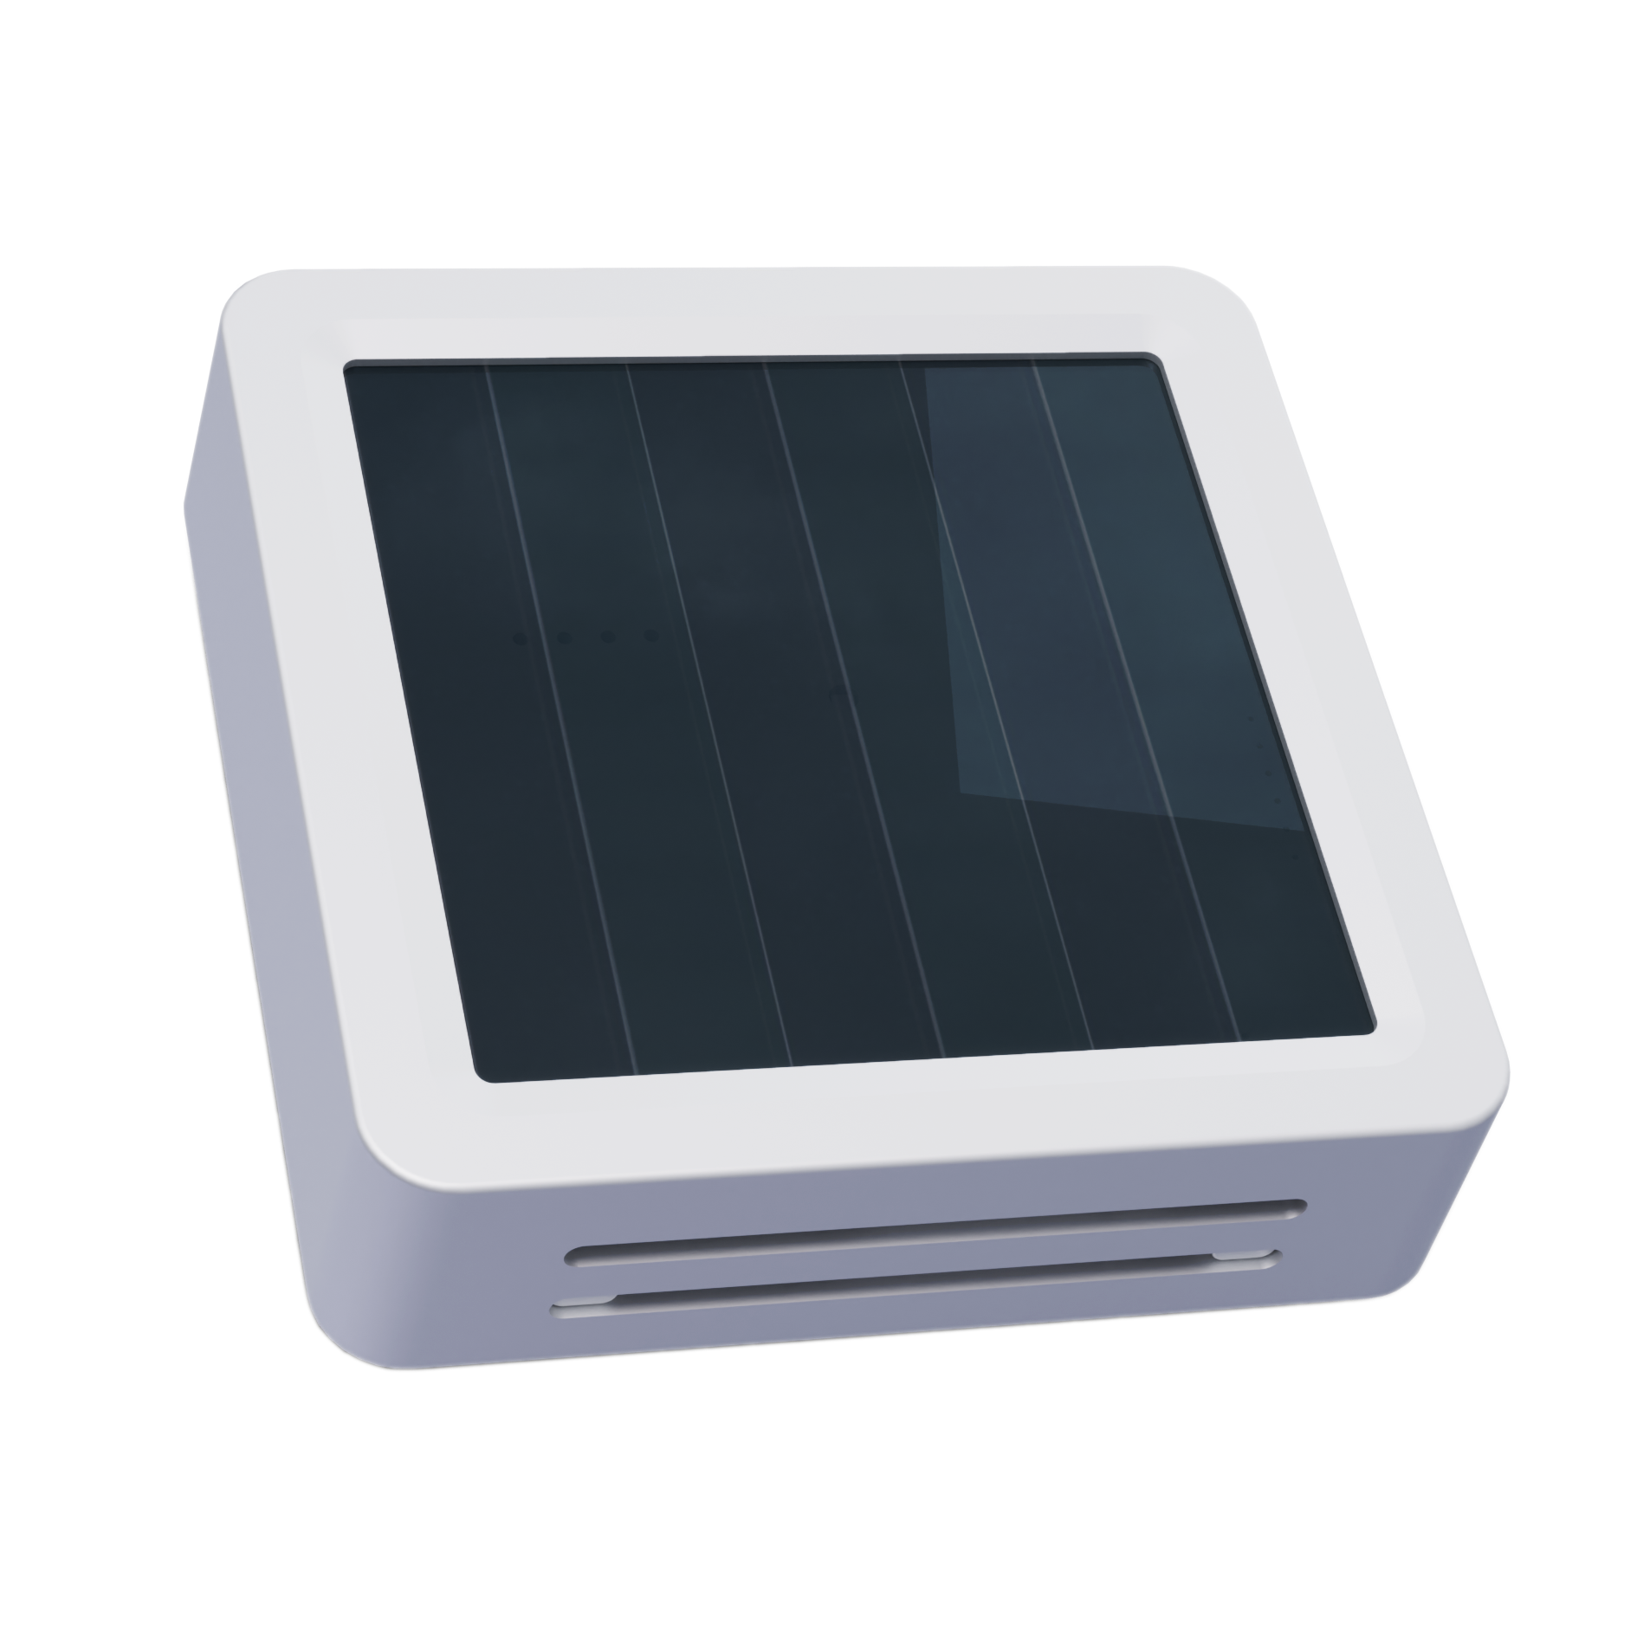
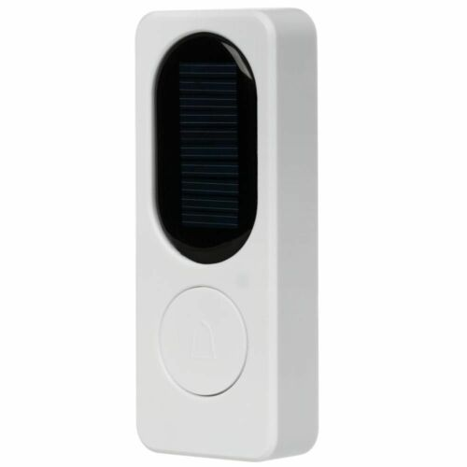
We make several insightful observations
Link Lab
Energy-harvesting sensors are replacing battery-powered device
Motion sensor
Movement and position sensor
Electronic shelf labels
Door/window sensor
CO₂ and Humidity sensor
Doorbell
Observation 1: PV cells are commonly used as a power source
Notes:
Observations that are-> PV cells are very commonly used in energy-harvesting devices. Because of their availability and abundance The output can be a personal signature While PV cell has been used as harvesters- but not particulary as sensor

Slide 7

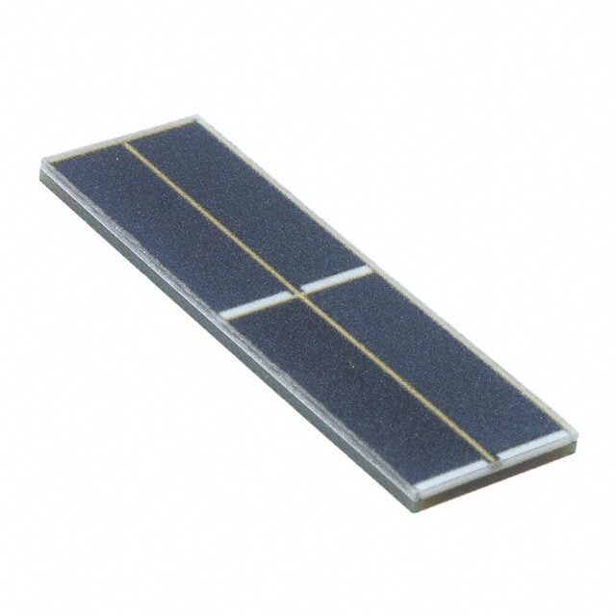

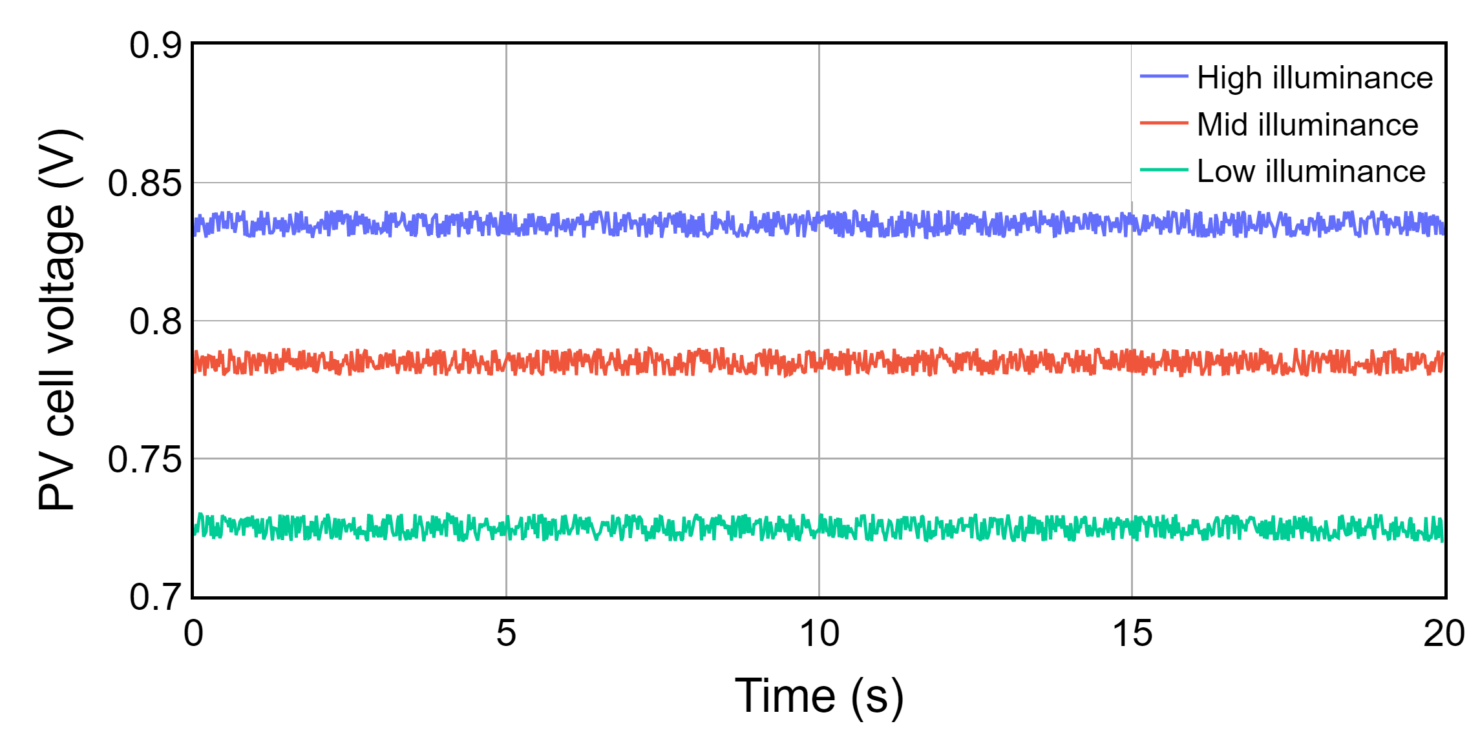
PV Cell open circuit output voltage characteristics
Link Lab
I_{SC}
I-V curve
Current
Voltage
V_{OC}
Observation 2: Without external influence, output changes steadily, nearly constant in short period of time
Notes:
Animation-> Person entering and leaving two different grahs

Slide 8


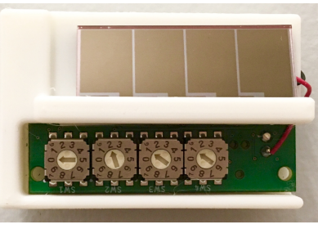
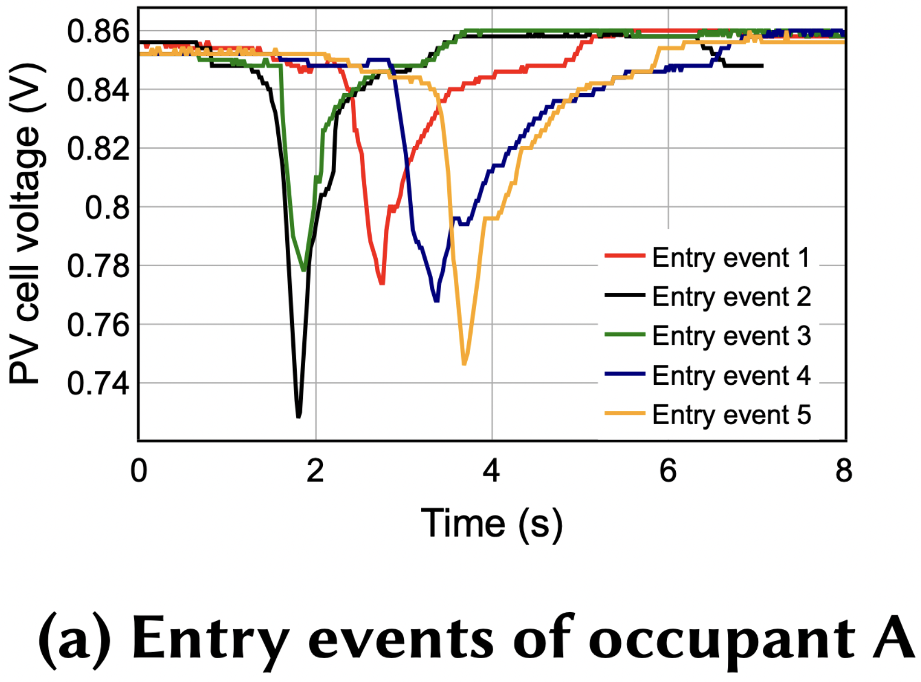
PV cell output voltage fluctuates when a person passes by the sensor
Link Lab
PV Cell voltage
Person A
Time
Notes:
Observations that are-> PV cells are very commonly used in energy-harvesting devices. Because of their availability and abundance The output can be a personal signature

Slide 9
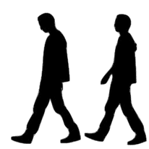
PV cell output voltage fluctuates when a person passes by the sensor
Link Lab
PV Cell voltage
Person B
Time
Observation 3: The voltage pattern is a unique signature of the person
Notes:
Observations that are-> PV cells are very commonly used in energy-harvesting devices. Because of their availability and abundance The output can be a personal signature

Slide 10
Voltage pattern changes with walking direction
Link Lab
Entry
Exit
Person A
Observation 4: The induced voltage pattern have a directional property
Notes:
Observations that are-> PV cells are very commonly used in energy-harvesting devices. Because of their availability and abundance The output can be a personal signature

Slide 11
Link Lab
We propose SolarWalk,
SolarWalk identifies occupants in smart homes based on their unique voltage pattern on a PV cell and determines their movement direction.
Notes:
Observations that are-> PV cells are very commonly used in energy-harvesting devices. Because of their availability and abundance The output can be a personal signature

Slide 12

SolarWalk Design: Event-triggered voltage sampling
Link Lab
Trigger generator
trigger
{Occupant id, Door event type}
SolarWalk Classifier
Module
User device/IoT device controller
MCU+BLE
[Voltage pattern]
sample
PV cell
SolarWalk Hardware
SolarWalk upgrades a PV cell to a person identifying sensor
Notes:
When to start sampling voltage traces, how to sample for the voltage At what frequency

Slide 13
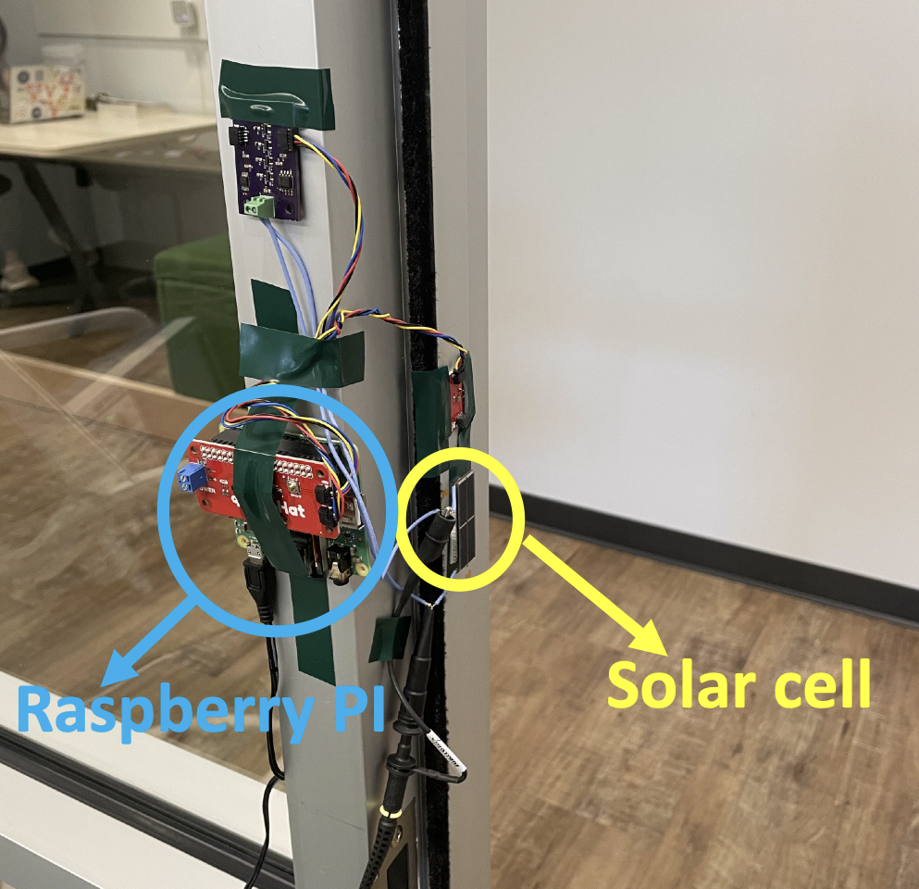
Data collection and hardware prototype
PIR sensor
nrF52840 board
Solar cell
Data collection platform
Hardware prototype

Slide 14
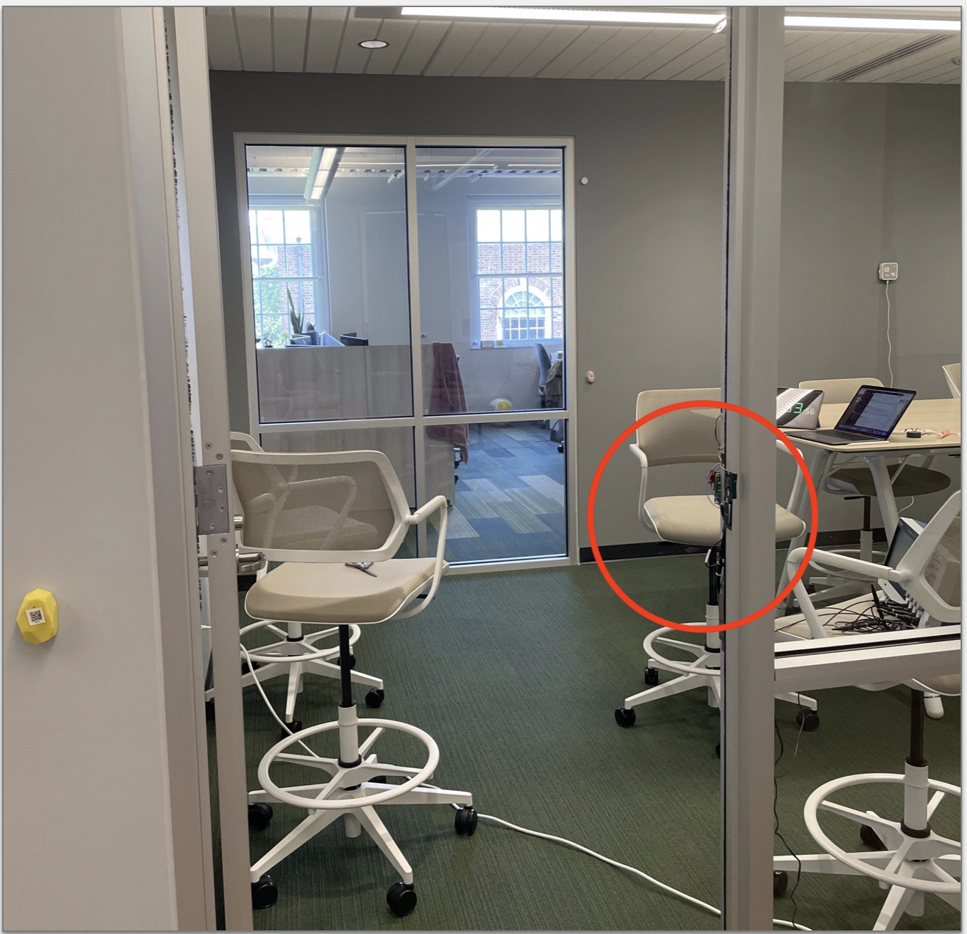
Collecting voltage signatures for identification
4 participants in 2 doors
1 participant in 1 door
Participants made 100 entry walks and 100 exit walks at each door
Each walk is 10 seconds long
Data collection hardware
Entry
Exit

Slide 15
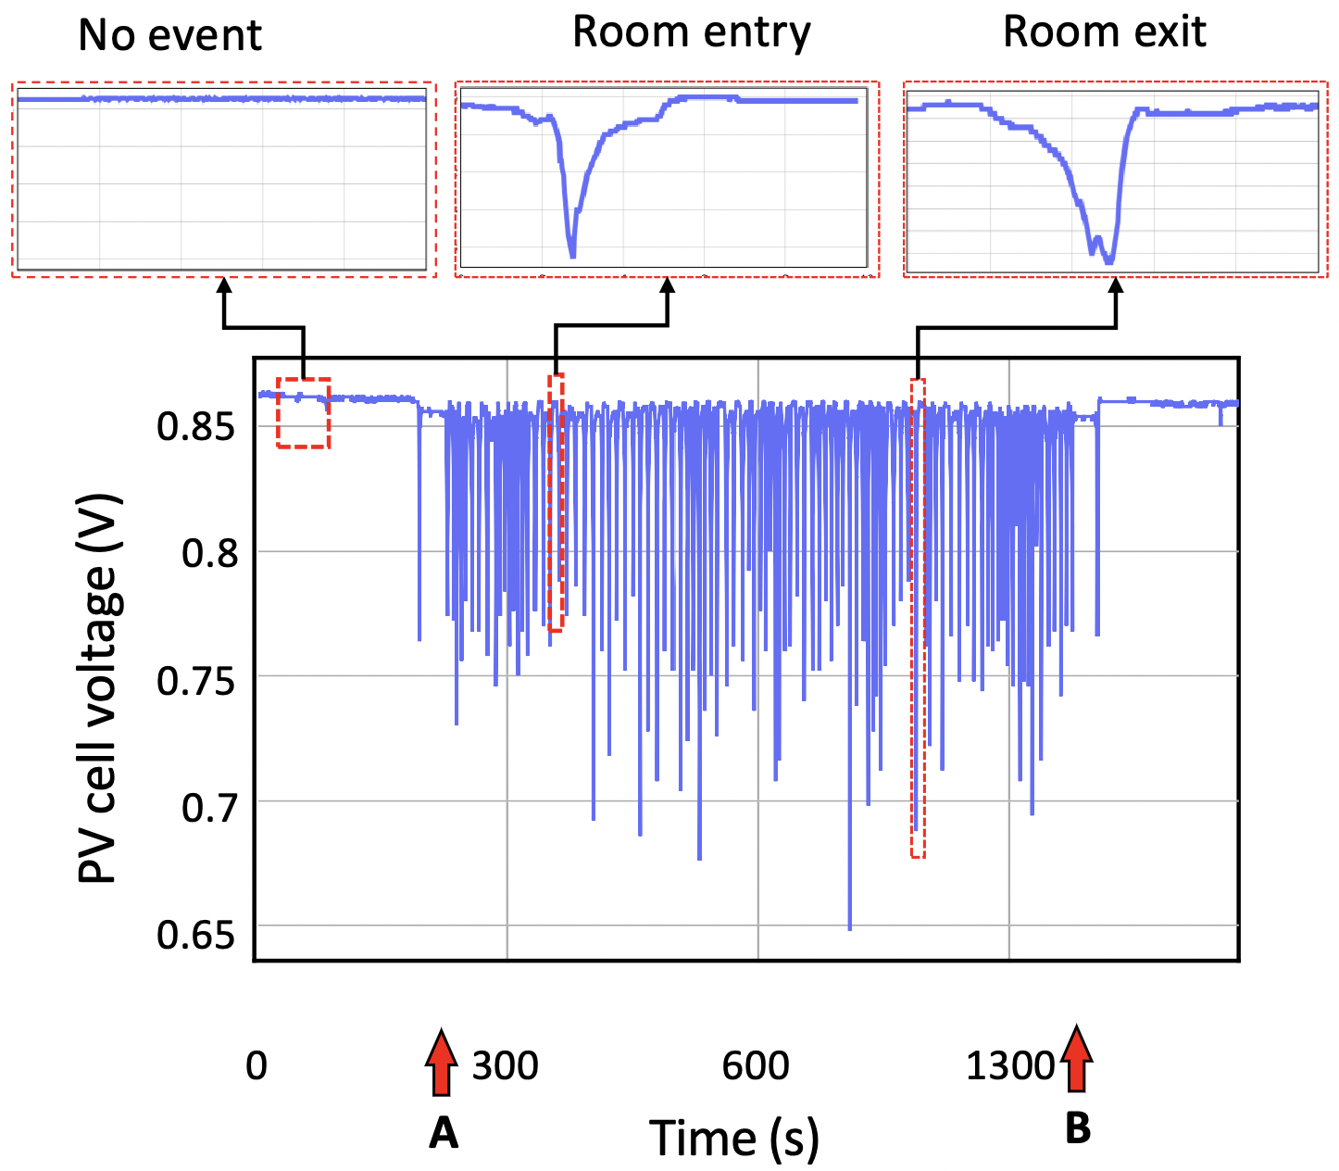
Example voltage trace from a single participant
Started walking
Stopped walking

Slide 16
How accurate is SolarWalk?
Link Lab
88% accuracy with 5 occupants
77% accuracy with 5 occupants
Notes:
Why is the event detection accuracy not 100% for one occupant?

Slide 17
Does accuracy vary throughout the day?
Link Lab
Identification
Event detection
Accuracy for identification and event detection does not vary significantly

Slide 18
How much deployment location matter?
Link Lab
Accuracy difference is within 3.9%
Accuracy drops at least 15% for Door 2

Slide 19
Accuracy vs Occupant height
Link Lab
Maximum height results in maximum accuracy

Slide 20
Concluding remarks
Link Lab
We present SolarWalk, an occupant identification system using small photovoltaic harvesters significantly improving deployability
SolarWalk demonstrates that a PV cell can be much more than a power source and converts it to a cheap, low-overhead sensor.
It is a stepping stone to enable more “harvester-enabled-sensing” applications.

Slide 21
Thank you!
Link Lab
Questions?
Nurani Saoda
saoda@virginia.edu
I am on the job market for academia and industry!

